Slide 1
Map of Tasks
Algorithms and Data structures

Slide 2
Introduction to IIOT
The Industrial Internet of Things (IIOT) represents a convergence of industry with the power of connected technology.
IIOT competitions aim to foster innovative solutions for real-world industrial challenges by engaging bright young minds.
Success in these competitions not only boosts academic prestige but also propels advancements in industrial automation and smart systems.

Slide 3
Task scheduling challenge
In preparation for the competition, students face a complex task scheduling challenge.
Each task, varying in complexity and time requirements, is a stepping stone towards building a competitive IIOT solution.
The sequential nature of these tasks mimics the dependency chains commonly found in project management scenarios within the industry.

Slide 4
Task structure explained
The tasks are organized into a rooted tree structure. The root represents the initial project concept, while subsequent levels symbolize the progression of subtasks and their intricacies.
The hierarchical nature of the task tree ensures a logical flow of knowledge acquisition and project development, with each node/task being a prerequisite for its children.

Slide 5
Restrictions on task execution
To mirror the focused effort required in real-world scenarios, each task can only be tackled by one student at a time.
This rule enforces the concept that while multitasking is common, deep work often requires undivided attention to a singular task.
'Cheating' is a unique rule introduced to simulate the process of leveraging existing solutions and knowledge bases available online.

Slide 6
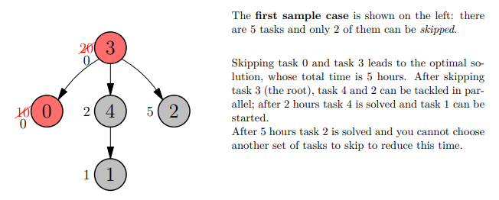
Visualizing the task hierarchy
Let's visualize this with a simple example: a task tree with 5 nodes, where each node represents a unique task with its own time requirement.

Slide 7
Task completion walkthrough
Starting with task 3, the root task, which is the foundation for all other tasks, we examine the tree for the most time-intensive tasks that, when completed, unlock the potential for parallel task processing.
We identify tasks 0 and 3 as the best candidates for 'cheating', thereby freeing up time and resources for other tasks.

Slide 8
Outcome and strategic impact
By 'cheating' on tasks 0 and 3, the total time required for all tasks decreases from a potential 20 hours to just 5 hours.
This optimized approach not only ensures timely completion but also exemplifies effective time management and strategic prioritization, essential skills for future industry professionals.

Slide 9
Overview of the algorithm
Our algorithm employs a depth-first search (DFS) strategy to traverse the task tree, analyzing and scheduling tasks from the leaves up to the root.
By traversing the tree, we identify the most time-consuming tasks that, if 'cheated', would yield the maximum reduction in total time required for completion.
This approach mimics dynamic programming techniques where optimal solutions to subproblems are cached and used to construct an optimal solution to the larger problem.

Slide 10
Data structures
Each task is represented as a node within a tree data structure, with pointers to parent and child tasks, encapsulating the hierarchical task dependencies.
We maintain an array to store the time required for each task, and a priority queue to determine the order in which 'cheats' should be applied to maximize time savings.

Slide 11
Algorithm steps
Initialize the task tree and populate each node with the respective task time.
Starting from the leaves, calculate the total time required for each subtree and propagate this information up the tree.
Use a priority queue to select tasks to 'cheat' based on the potential time savings, prioritizing the highest values first.
Update the total time at each node after applying a 'cheat', ensuring that the integrity of the task dependencies is maintained.

